Slide 1

OADF
Optimal Athlete Development Framework
British Swimming, and home nations. Kevin Renshaw, Tim Jones, Graeme Antwhistle, Alan Lynn, Lindsay Dunn

Slide 3

Long Term Athlete Development
Work in progress?
Overly prescriptive?
Principally, the model is only one-dimensional, there is a lack of empirical evidence upon which the model is based, and interpretations of the model are restricted because the data on which it is based rely on questionable assumptions and erroneous methodologies. (Ford, 2011)
Talent development is holistic in nature due to the complex interaction of interdisciplinary issues that directly impact on athletic opportunity and progression. (Ford, 2011) eg Hormones, maturation etc
Balyi and Hamilton (2004) highlight that their work is based on ‘‘empirical observations’’, which although apparently well informed, lack scientific validity due to inherent subjectivity issues.

Slide 4
A new way forward (OADF)
What is it?
Designed by British Swimming, Home Nations, Coaches, support staff, and athletes
It’s a framework / guide, not a prescription
Framework considers the swimmer as an athlete, a person, and a performer
Helps coaches focus on attributes that will enable swimmers to be top performers
ACCESS – defines culture of our sport
Sets the direction of our sport for everyone involved – compare yourself or club to OADF

Slide 5

OADF continued
Enhances coaching – focusing coaches on major factors for swimmers development
Variety – allows different approaches to produce top level athletes (non-prescriptive)
Development – will help guide coach and swimmer development programmes
Allows for appropriate support and resources to be developed
Reference Off the Blocks

Slide 6
How to implement OADF in your home programme
Wycombe Swimming club example – Kevin Brooks

Slide 7
How Durham County Council / Derwentside implement OADF
Head coaches philosophy / aims – athlete centred programme (nurture the athlete), athlete journey (education, development), coach CPD (all understand the process)
Athlete monitoring – daily wellness, reflections, training load monitoring, maturation monitoring (shaping training programmes accordingly).
Communication – swimmers, parents, committee
Support network – nutrition, psychology, physiology
Sports science implementation – training schedules, S&C, athlete support
Working with partners, CDS, Universities, N&D etc
Athlete Centred, Coach Led, Culturally defined, Expert Informed, Science Supported, System Aligned

Slide 8
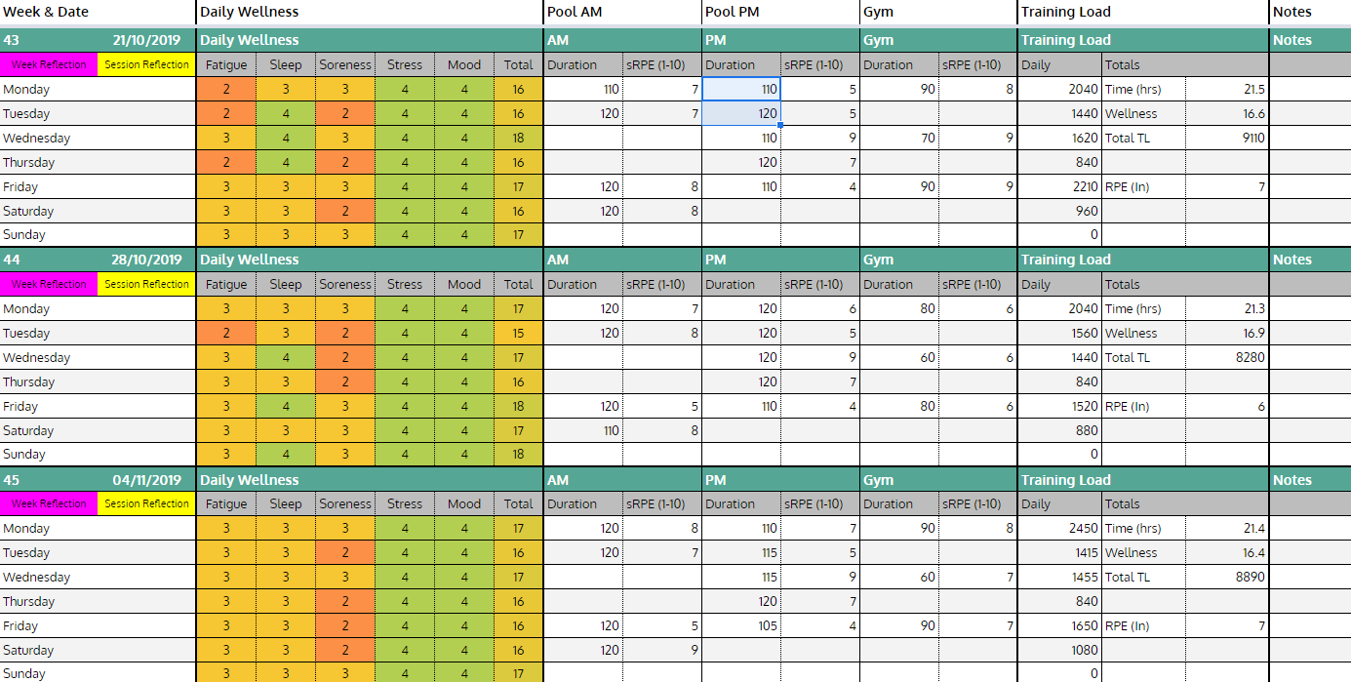
Athlete training load diary including daily wellness, pool and gym based session. Session training load (AU) measured using equation sRPE x Duration. Sheets are shared between athlete and relevant coaches (Head Coach & Sport Science) to receive live updates on athlete wellbeing, state and readiness to train and total training burden place upon the athlete.

Slide 9
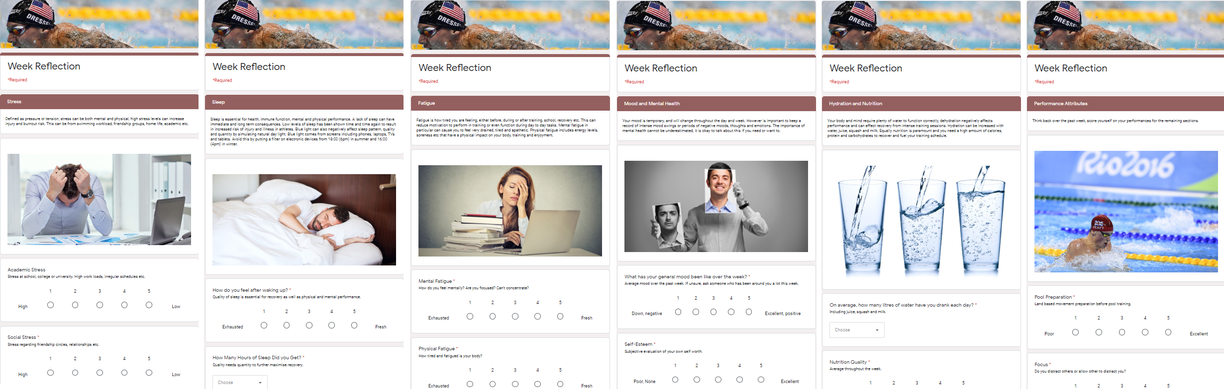
Athletes are encouraged, not forced, to undertake weekly reflective practice. This serves as a introductory framework to examine and learn about their own practice through critical reflective thought, making learning sticky and long-term.
Asking the athletes to identify the causes of distress in their personal lives, and to find solutions.
Sleep is essential for recovery, reflection may help them to uncover issues with sleep routine.
Some athletes don’t know or realise they are fatigued. Critical self evaluation may change this.
Decreases in mood can highlight central neural fatigue, while monitoring mental health is equally important as physical health for total athlete wellbeing.
Everyone knows what a healthy diet is, getting the athlete to identify and make healthy choices is more difficult.
Critical thought to personal qualities that will enhance and maximise athletic potential.

Slide 10

Learning doesn’t just happen,
a purposeful effort and want to learn
by the athlete is paramount. The coach may enhance
this process through pedagogical strategies
by making the learning process more difficult,
this helps to switches off the athlete ‘autopilot’
by facilitating cognitive effort.
The athletes can also be encouraged to enhance
the learning process. After a certain period of time
to consolidate the new information the athletes are
encouraged to reflect on meaningful learning experiences.
Retrieval of information reinforced neural
networks and connections (synapses), further
solidifying the newly learnt material.
The athletes are introduced to self driven reflection
through the Gibbs Model of Reflection. A series of
questions to help the athlete critically reflect, examine
and learn from the content of training sessions.

Slide 11
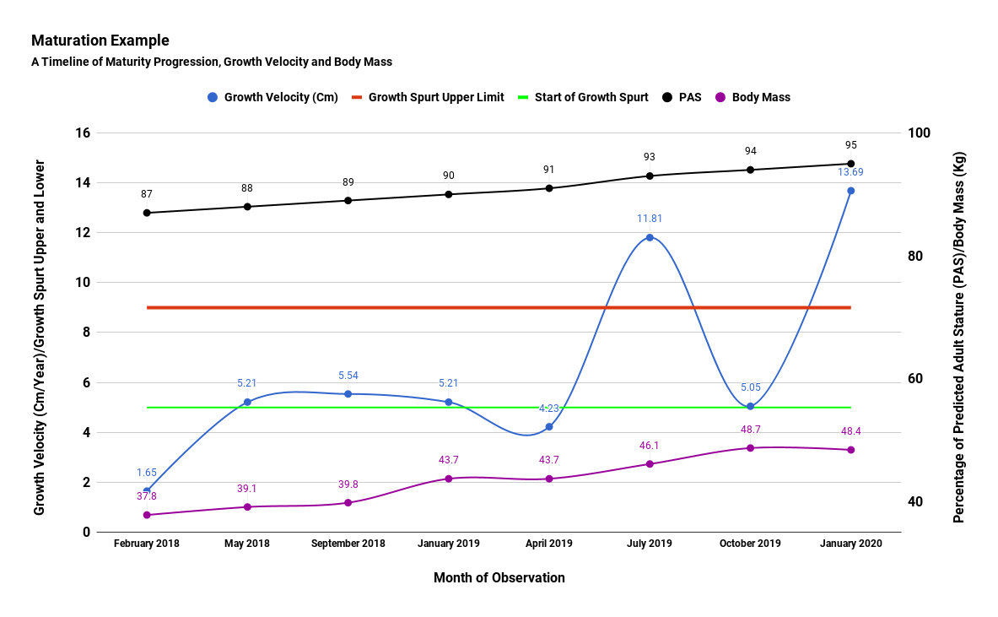
To keep youth athletes safe, injury free and
progressing their development, coach must
understand maturation. Coaches must know the
status, timing and tempo of each athletes individual
development using methods such as the
Karmish-Roche.
Status: Pre-pubertal, early pubertal, mid-pubertal
and late pubertal. Are they in a growth spurt?
Timing: Are they early, on time or late developers?
Early developing athletes can often handle more
intense training, often selected for junior teams.
Late developers need reduced work and may need
psychological coaching and reassurances to keep
them in the sport.
Tempo: How fast or slow are they growing?
Higher growth velocities increase risk of overuse
injuries (Osgood, Severs).

Slide 12
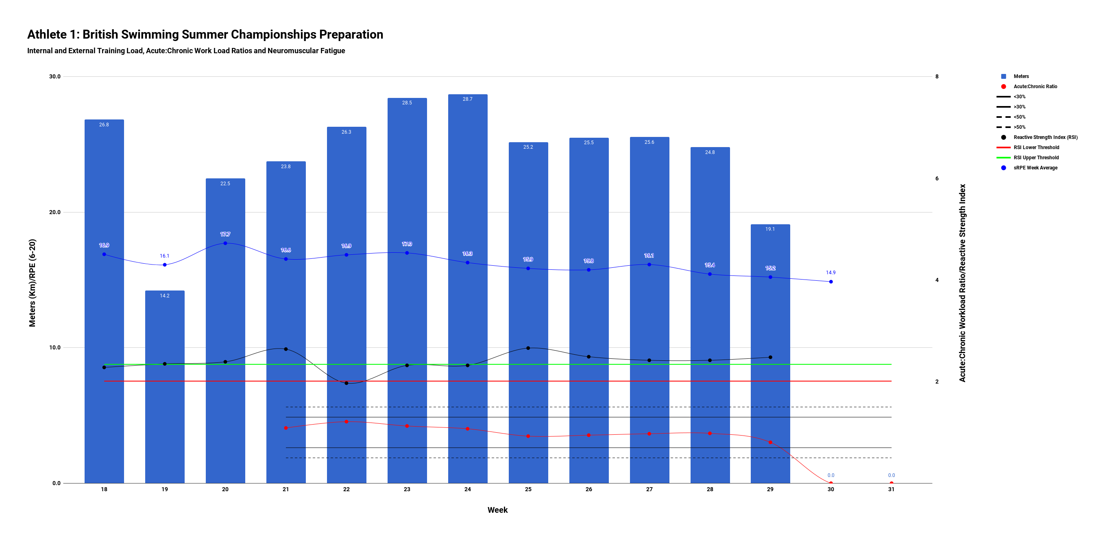
Building a profile of each athlete is critical to
ensure the training is working, if it’s safe and to
maximise the health and performance of the athletes.
Recording of meters completed is critical to ensure
you, the coach, are installing the principle of
progressive overload and ensure the gradual
build up of volume and intensity to load the
athlete over time. While not black and white,
it may also help to keep the weekly training load
within 30% of previous 4 weeks average.
Athlete internal perception of the work completed
as well as a test of neuromuscular fatigue is
paramount to assess the effects of the training
process on the athletes. A test such as a drop jump
once technically proficient is an example of one
method of fully body neuromuscular fatigue monitoring.

Slide 13
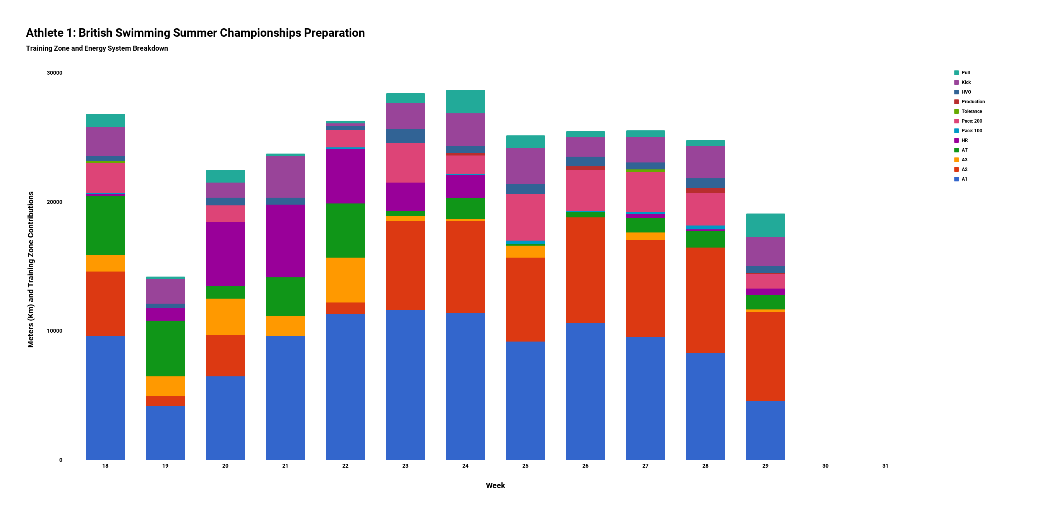
1 meter is not equal to another.
100m at A1 is not the same as 100m race pace.
Therefore coaches must be sure to record how
many meters each athlete performs at each intensity
to gain a much richer picture of the training
burden placed upon the athletes.
This is also extremely beneficial for coaches at the
end of each training cycle to assess what
worked and did not work for their athletes.
Without data such as thing is it much more
difficult if not impossible to truly gauge the key
mechanisms that lead to the efficacy, or lack of,
during a training cycle.

Slide 14

Final thoughts / discussion?
LTAD v OADF – Too prescriptive v Non Prescriptive
How do you or how could you implement OADF in your programme?
A lot of time spent on softer skills eg Arena Skills
Need more education on science, physiology, training models, periodisation
OADF – only focuses on Age group and above
How has OADF helped your programme?

