Slide 1

Strategic Review and Recommendations for Water Polo
2015 – 2024
January 2015

Slide 2
Project methodology
Desk research:
  ASA & BS structure & strategy
  Membership & club statistics
  Performance standards & results
  Competitions structure
  Workforce development programmes:
    Other sports as a comparator
  Previous water polo reviews
  Regional development plans
  Various websites – national / regional / local
One-to-one interviews:
  38 F2F / Skype / telcons
  Two written submissions
Online survey:
  726 respondents = >10% of estimated total constituency
  53% current players, 32% coaches, 27% parents, 15% referees, 16% table officials
  Distribution across England reflects water polo map:
    10% SCO / WAL
  76% current ASA members
  52% water polo only, no other aquatic involvement
  73% involved for >5 years
  45% aged >40 years

Slide 3
SWOT analysis
Strengths / Opportunities
Weaknesses / Threats
Numbers of dedicated and able volunteers
Regional partnerships and pockets of good practice (North-West, London)
Beacon clubs, and others, trialling recruitment and development
National competitive framework and organisational capacity of the BWPL
Strong presence in independent schools
Number of universities playing WP
Efficiencies within training and competition
Increased awareness from 2012 of the requirements of high performance
Pay-to-play culture within the sport
Available pockets of resource on a local / regional basis
Lack of leadership – vision / plan / co-ordination
No co-ordination of existing resource
Lack of pool-time / swimming as an inhibitor
No clear pathway into / through the sport
Club culture: threat of emerging learned helplessness / absence of a training culture
Talent pathway favours the most available, not the most able
Lack of an elite domestic competition as a focal point
“2012-itis”
Coaching: high cost of CEP / no Level 3 / poor technical coaching in clubs
Ageing / declining officials workforce

Slide 4
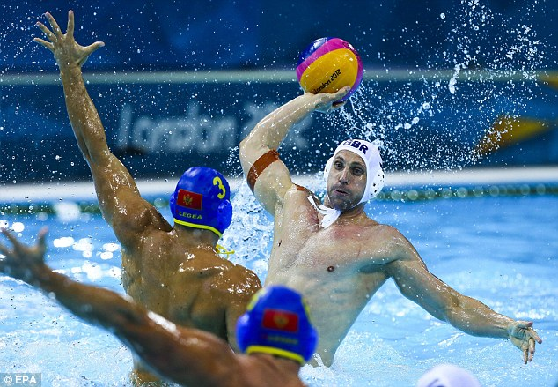
Areas for attention
Leadership, governance & management
Performance
Talent pathway
Competitions development
Participation & club development
Workforce development
Marcomms
Finance and resource

Slide 5
Leadership, governance and management
Water Polo Management Group
Need to rebuild trust … and unification
WPMG a portfolio- / competence-based group:
  Sub-group chairs comprise the WPMG
  Open and transparent recruitment against clear role descriptions, based on demonstrable capability to fulfil the role
Independent Chair and Manager:
  Chair is titular head – sits on ASA SGB …?
  Independence to retain an external view
Clear ToR, including agreed responsibilities and powers:
  WPMG needs the requisite powers to fulfil its duties
  Critically important to predetermine areas of control / delegated authority – e.g., fund-raising, budgets, staff management & deployment
Governance & audit
Participation & clubs
Performance pathway
Competitions & events
Workforce development
Marcomms & commercial
Sub-committees operated by sub-groups as
required, e.g., coaching, match officials by
Workforce Development

Slide 6
Leadership, governance and management
Regional forum – periodic gathering of 8 x WP committee chairs / managers to share information / expertise
Annual WP conference – for WPMG to report on delivery of strategy, and demonstrate accountability to the sport
GBR strategy / management group comprising:
  WPMG Chair and Performance Pathway rep
  SCO & WAL representatives
  Determines all matters relating to GBR teams, clubs and officials, in international competition
  Requires clearly and properly delegated authority from BS to do this
Longer-term cost-benefit analysis / feasibility study regarding an independent NGB for WP:
  WP is an uncomfortable fit within a swimming NGB:
    “Black sheep of the family”
    Team sport vs individual sport
    Swimming a rival for pool-time / inhibitor to growth
  Precedent within other, successful WP nations:
    BUL, CZE, HUN, ROM, SLO, SRB, SVK, TUR
  Acknowledge that WP may not currently be in the place to pursue UDI – but there is undoubted value in exploring the potential, the steps required, and the profit / loss to be generated:
    Even if the answer is no …
  Opportunity to review issues of ASA membership around, inter alia, schools and universities

Slide 7
Performance
Online survey showed the strong desire of the WP constituency for a meaningful GBR international programme; also need for an aspirational tier at the top of the domestic / talent pathways
Beware “2012-itis”:
  London OG / WCP was a spike, and not the normal trend – unique circumstances, not repeatable in the short- to medium-term
Rio 2016 OQS:
  GBR men and women needed to win EC / top three in OQT
  EC track record and current WR suggests that this is highly unlikely:
    Men at best 12th in EUR
    Women at best 7th in EUR
  Agree that there was no value in pursuing OG qualification
Propose that GBR steps out of senior EC for an initial period of two years, in order to improve performance underpinning:
  Progressive pathway
  Training culture
  Regular, intense domestic competition
Plan short-term, senior-level future as ENG:
  Summer-based international programme on self-funded basis, as progression from Talent pathway
  Align with home nation programmes, i.e., 4/5 Nations, 8 Nations
  Continue to pursue Commonwealth Championships
Ten-year programme to construct performance underpinning:
  Progressive pathway; training culture; regular, intense domestic competition
  Review points along the way, as to when circumstances allow return to EC qualification
  Long-term aim to qualify team(s) for 2024 Olympic Games

Slide 8
Performance underpinning: talent pathway
Revision required as part of a wider vision to improve performance underpinning:
  Progressive pathway
  Training culture
  Regular, intense domestic competition
Currently efficient, but not effective:
  Favours those most able to pay
  Focused on tournament teams, not pathway players
  No clear athlete profile
  No tangible outcomes at international level
Clear purpose and structure for the pathway:
  Support GBR outcomes at senior level
  LTAD framework as the basis
Learning to Train at U14:
  Weekly training at 20 x RTCs at Years 7-8 / age 11-13 – with dry-side S&C outline
  Competitive outlet: inter-counties → inter-regionals at U14
Training to Train at U16:
  Regional, not GBR / ENG – up to 8 x regional programmes at Years 9-11 / ages 13-16
  Up to 8 x Regional Performance Centres with nationally appointed and supported Regional Coaches:
    Potentially clubs / schools / universities / facilities
    Bristol & Manchester already in place through Beacon programme
  11 x monthly training sessions p.a. as a minimum – as often as is practicable
  Focus on individual skills development, and dry-side generic SSSM education (S&C, nutrition, injury prevention, basic psychology)
  Competitive outlet: inter-counties → inter-regional competition → international competition
  M&E / QA nationally around coaching standards
(RTCs function at two levels:
  Years 7-8, for skills acquisition and development under coaches prior to identification / selection into regional programmes
  Years 9-11, for (a) regionally identified talent to access pool-time under coaches; and (b) potential late developers to train on)

Slide 9
Performance underpinning: talent pathway
Training to Compete at U19:
  National programme at Years 11-13 / ages 16-19
  National Coaches, one per gender, with technical responsibility for athlete profile, all national teams’ style of play, etc.:
    Also position-specific coaching consultants
  11 x monthly training sessions p.a. as a minimum – as often as is practicable
  Individual development plans for all nationally identified players
  Competitive outlet = GBR U17 and U19 teams in EC / ESSA U18 team:
    Shared cost / programmes with SCO / WAL for GBR?
  Clear exit routes into (a) elite domestic competition, and / or (b) university hub … aiming to peak at age 25
  (Possibility to align TASS / AASE programmes within college(s) to support this stage)
  (Longer-term possibility of U18 competition within elite domestic competition?)
National, 16-19: Training to Compete
Regional, 13-16: Training to Train
Up to 8 x RPCs
Local / regional, 11-13:
Learning to Train
20 x RTCs
National Men’s / Women’s
Coach
8 x Regional Coaches
<20 x RTC Coaches

Slide 10
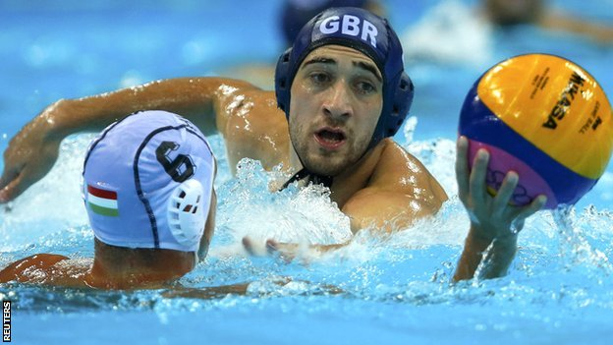
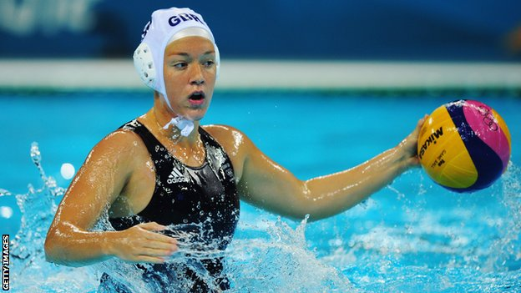
Performance underpinning: training culture
Take time to build an improved training culture and environment in clubs / facilities (Training to Win):
  Currently training ~4-6 hrs p.w. vs EUR teams 2-3 hrs p.d.
At top end, suggest 4 x ball sessions, 4 x swimming sessions, 3 x gym sessions = 16-24 hrs p.w.:
  Cascaded through the age grades, so that constant build-up from youngest ages
  Supported by athlete, parent and coach education
Acknowledge that available pool-time is an inhibitor – but what is the alternative?
  Need to identify clubs / centres / facilities where targets are deliverable
  Value in university programmes, utilising scholarships / shared value in elite programmes

Slide 11
Performance underpinning: training culture
Age | School Year | LTAD stage | Training requirement | Hrs p.w.
Under 9 | 3-4 | Fun-based introduction | 1-2 hrs p.w. – learning to swim / fun-based play | 1-2
9-11 | 5-6 | FUNdamental | 1-2 hrs p.w. learning to swim 1-2 hrs p.w. Mini Polo play | 2-4
11-14 | 7-9 | Learning to Train | 4-5 hrs p.w. core skills training / Cadet Polo play 2-3 hrs p.w. swim fitness 1-2 hrs p.w. dry-side S&C | 7-10
14-16 | 9-11 | Training to Train | 6-7 hrs p.w. core skills / team training / match-play 2-3 hrs p.w. swim fitness 1-2 hrs p.w. dry-side S&C | 9-12
16-19 | 11-13 / FE | Training to Compete | 8-9 hrs p.w. core skills / team training / match-play 2-3 hrs p.w. swim fitness 2-4 hrs p.w. dry-side S&C | 12-16
19-23 | 13 / FE / HE | Training to Win | 8-9 hrs p.w. core skills / team training / match-play 4-9 hrs p.w. swim fitness 4-6 hrs p.w. dry-side S&C | 16-24
23+ | HE / employment | Training to Win | 8-9 hrs p.w. core skills / team training / match-play 4-9 hrs p.w. swim fitness 4-6 hrs p.w. dry-side S&C | 16-24

Slide 12
Performance underpinning: competitions development
Felt needs include a structured season, Sept – May, with and agreed hierarchy of competitions:
  Key role of Competitions & Events Sub-group to deliver this
Regular, intense, top-level domestic competition underpinning performance (Training to Win):
  Best against the best, week in, week out
  Uncertainty of outcome, “to-the-wire” matches
  Minimise the distance between domestic and international sport
  (Creates commercial properties / spectator potential / revenue generation / increased awareness)
Junior & youth competition programme which:
  Increases amount of quality match-play available to young players, for purposes of retention and development
  Is aligned with athlete development pathway / periodised in support of outcomes
  Addresses current imbalance between domestic and representative WP
  Consolidates activity across schools and club sectors
  Is sympathetic with players’ academic commitments
Development of match officials to support the calendar:
  See below on shortage of match officials – “no ref, no game”

Slide 13

Competition formats
Athletes’ needs
The format
Coaches’ needs
Competition

Slide 14
Competition pathway
Age | School Year | Competition Focus | Current competitive outlet | Recommended game format
Under 9 | 3-4 | Fun-based introduction | Intra-school / club competition | UKSG Aquasplash Footy
9-11 | 5-6 | FUNdamental | Intra-school / club competition Local inter-school / club competition | Mini Polo
11-14 | 7-9 | Learning to Train | Local inter-school / club competition ESSA U13 competition Inter-counties → U14 inter-regionals | Cadet Polo
14-16 | 9-11 | Training to Train | Local inter-school / club competition U15 National Age Group Championships / ESSA U15 competition Inter-counties → U16 inter-regionals | Full Water Polo
16-19 | 11-13 / FE | Training to Compete | Local inter-school / club competition U17 National Age Group Championships ESSA U18 competition / DoC Cup Inter-counties → U18 inter-regionals U19 National Age Group Championships
19-23 | 13 / FE / HE | Training to Win Social & recreational | BUCS / Upolo university competition Open-age club leagues: BWPL / British Championships Regional & county leagues
23+ | HE / employment | Training to Win Social & recreational (c) Returners and Masters | BWPL / British Championships Regional & county leagues
Requires revision / consolidation so that FFP against desired outcomes

Slide 15
Performance underpinning: competitions development
Elite League / BWPL Premiership
Eight-team competition,
season-long, H / A
Changes in train within British Championships are a step along the road towards greater intensity within the domestic season:
  Further progression required to deliver a compelling performance / commercial offer
Medium-term vision to have a minimum standards-based elite league at the head of the BWPL comprising the best-appointed clubs / centres competing in top-level facilities on a season-long basis:
  Minimum facility requirements, including dry-side access to S&C
  Pool time to allow 6-9 hours ball work p.w., and 6-9 hours lane swimming
  Quality-assured coaching structures
  Junior & youth development programmes / links
  Senior men’s and women’s teams
Open opportunity for other clubs to aspire to this level, if they qualify for promotion and can fulfil minimum standards requirements:
  Diminished standards at different levels, to help build towards elite …?
Promotion subject to
fulfilment of
minimum standards
BWPL Regional 1
BWPL Regional 1
Central-venue matches
Play-offs involving
crossover matches
BWPL Regional 2
BWPL Regional 1
Player registration
permits athlete
involvement at
different levels
Regional Leagues (as current)
Local Leagues (as current)

Slide 16
Regional hub sites
Up to 8 regional hubs
Olympic pool
Dry-side S&C
Facility access
Quality coaching input
Competitive outlets: club, region
Access to SSSM
Junior / youth programmes
Where? Full-size Olympic pools in:
Bristol
Leeds
London
Manchester
Plymouth
Sheffield
Sunderland
50m university pools in:
Bath
Guildford
Loughborough
Norwich
Birmingham (planned)
14 x other 50m pools including:
Aldershot
Corby
Liverpool
London boroughs
Nottingham (planned)
Portsmouth
One of these identified as a national centre?

Slide 17
Participation and club development
Estimated 7000 active WP players:
  Registration imprecise, needs better data
  7.5% of ASA Category 2 membership
  Cf. lacrosse (16,000), baseball / softball (21,000), volleyball (42,000)
Lots of “pub teams” – fewer “clubs”:
  Club = multiple teams, pyramid structure, training culture, etc.
Flawed assumption that LTS will produce more players – need agreed, progressive introduction via small-sided games
Structured recruitment through quality programmes:
  Coaching in schools / Sportivate
  Swimming pool / leisure centre programmes
  Strong and clear links into quality clubs
Recruitment / retention requires a quality experience in clubs:
  Coaching
  Training into appropriate competition
  Pool-time
  Facilities
  Safe and well-managed
Emerging Beacon club model for an agreed hub-club framework:
  School-club links
  University-club links
  Hub-satellite links
  Level separation between hub and satellites
  Need for clarification and communication of this model, to address current fears within the sport
UKSG Aquasplash Footy
Mini Polo (no rules)
Cadet Polo (modified rules)
Full WP
Proposed age-and-stage pathway:
FUNdamental / Learning to Train

Slide 18
Workforce development
Coaching
Match officials
Quality and quantity key to all of the above – critical priority area
Pre-Level 1 course(s) – “Ready to Coach”:
  Comprising generic elements of current Level 1
  Amend Level 1 to include additional technical content
  Review Level 2 in light of the above
Finalise and propagate Level 3
Develop WP-specific CPD modules for L1-2, with online resources
Address cost of CEP:
Ageing population, declining numbers, places intolerable burden on handful of individuals:
  6-12 top-end officials, majority at D Grade, few in the middle – hiatus in the pipeline
Why so few? High demands, low job satisfaction:
  Including through player abuse / inappropriate disciplinary framework
Urgent action required, including:
  Pathway review under way, requires support
  Promotional initiative to drive recruitment
  Introduce “Junior Whistler” award, or equivalent
  Finalise table officials award under development
  Clean database of current, active officials
  Introduce Code of Conduct / Respect campaign, to protect officials
  Introduce WP-specific disciplinary process, aside of ASA, to deal quickly & efficiently with serious incidents
 | FA | RFU | RFL | EN | IoS / WP
Level 1 | 100-175 | 100 | 140 | 150 | 192-370
Level 2 | 100-175 | 138 | 200 | 360 | 620-650
Level 3 | 450 | 750 | 850 | 1200 | ???

Slide 19

Marcomms
Clearly identifiable brand to unify the sport:
  “England Water Polo” …?
  Logo for use in all communications
Consolidated internet presence:
  Dedicated website / web-page
  Single point of reference for all content / information
  Linked to social media outlets
Improved communications with the sport:
  AGM-style meeting for WPMG to report to members against strategy / gather feedback

Slide 20
Finance and resource
Baseline talent pathway budget might be = £254,800 p.a. (illustrative) – comprising:
  Sport England Excel programme net of salary and on-costs = +/- £40,000
  20 x RTCs x 40 players @ £180 p.a. = £144,000
  8 x RPCs:
    8 x 60 players x 11 monthly sessions @ £20 = £13,200
    8 x RMB WP budgets @ ave £5000 = £40,000
  National programme: 80 players x 11 monthly sessions @ £20 = £17,600
  (Plus self-funding for overseas training / competition; ESSA programme; TASS / AASE programmes, etc.)
Current additional sources of income = £292,000 p.a.:
  Beacon club programme, £50,000 x 4 for 3.5 years to Mar 2017 / £57,000 p.a. @£14,250 p.c.
  London WP Development Programme: £100,000 p.a. via Sport England for two years to Mar 2016
  Manchester City Council investment in WP:
    Development programme @ +/- £35,000 p.a.
    Beswick Leisure Centre @ £90,000 p.a. VIK
  BS input into British Championships: £10,000
(Plus ASA administrative overhead, and competition support; regional subsidies for CEP, etc. – significant VIK in return for ASA membership subs @ £125,000)
Annual water polo budget might therefore begin at c.£675,000 p.a. – if consolidated and viewed as a single piece
Potential additional sources of income:
  Capitation / ringfenced membership fee
  Sportivate
  Sport England small grants programmes
  London 2012 legacy funds
  Olympic Solidarity Fund
  Viz. VE £1 million challenge in 2014, inspiring the game to raise these funds – it did …

Slide 21
Headline summary
New leadership, governance and management structure with clear powers & responsibilities
GBR programme for men and women to be suspended pending reconstruction of the support structures:
  Progressive pathway
  Training culture
  Regular, intense, elite domestic competition
ENG programme to be instituted in the interim
Revision of talent pathway, including regionalisation up to age 16, and more focus on individual athlete development
A revised domestic competition structure and calendar to raise standards at the higher levels
A focus on those clubs / centres (n~8) most able to meet standards and deliver development / training / competitive outcomes
Agreed introduction to the sport via modified formats of the game
Definition and promotion of a “quality experience” at club level to support recruitment and retention
More and better coaches, through a more comprehensive and affordable education programme
More referees and officials, to address current shortages
Improved communications, making best use of internet technology and social media
Unification of the sport domestically under the brand “England Water Polo”
Consolidation of existing finance / resource within a “water polo budget”

Slide 22

Questions and comments?

